Slide 1
Applied Data Science Machine Learning in Python
Dr. Omri Allouche
2017

Slide 2
Refresher
http://machinelearningmastery.com/tutorial-to-implement-k-nearest-neighbors-in-python-from-scratch/

Slide 3
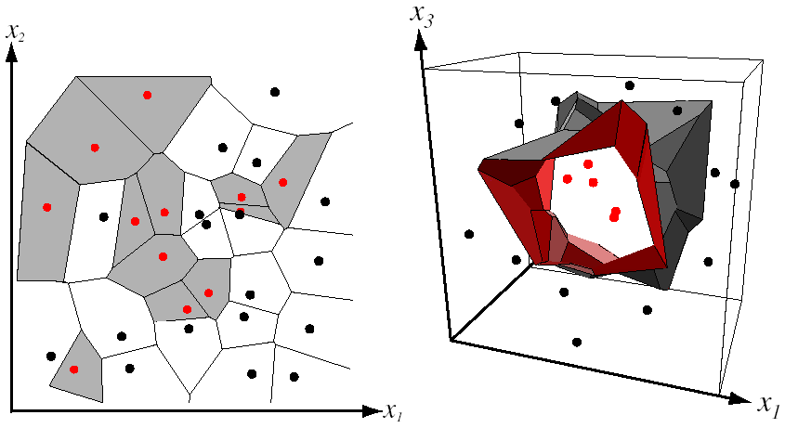
Nearest Neighbor Classifier
Assign label of nearest training data point to each test data point
from Duda et al.
Voronoi partitioning of feature space
for two-category 2D and 3D data
Source: D. Lowe

Slide 4
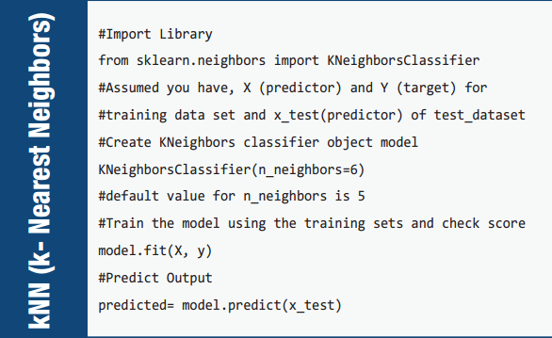

Slide 5
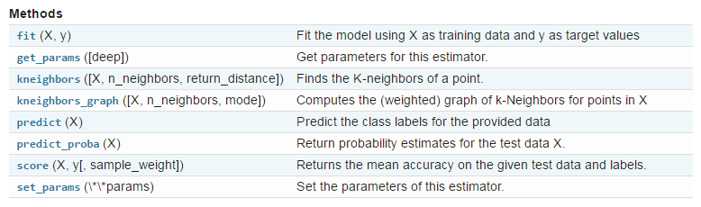
Methods

Slide 6
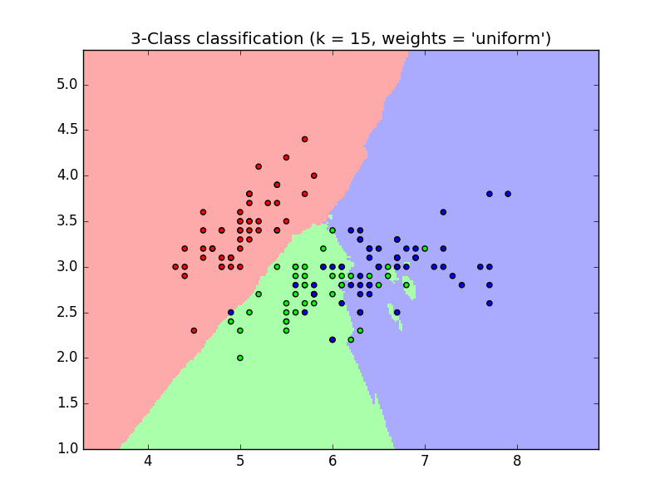

Parameters
http://scikit-learn.org/stable/modules/generated/sklearn.neighbors.KNeighborsClassifier.html

Slide 7




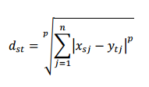




Distance Metrics
 | Manhattan distance
 | Euclidean
 | Minkowsky
 | Chebyshev
 | Mahalanobis
 | Cosine
 | Hamming
 | Jaccard
 | Spearman

Slide 8
Potential Issues
How to handle missing values?
How to handle categorical data?
What to do if features have different scale?
What if some features are correlated?
What if some features are more important than others?

Slide 9
When to use?
Let’s discuss how KNN behaves in regards to these topics:
Scalability
Speed of training
Speed of prediction
Interpretability
Dimensionality
Sensitivity to outliers
Missing data
Dependence on parameters
Notes:
Doesn’t scale well
Larger k reduces sensitivity to outliers. Less sensitive overall
KNN doesn’t explain effect of features on target variable
Doesn’t handle missing data well
Requires tuning of K
Slow during production

Slide 10
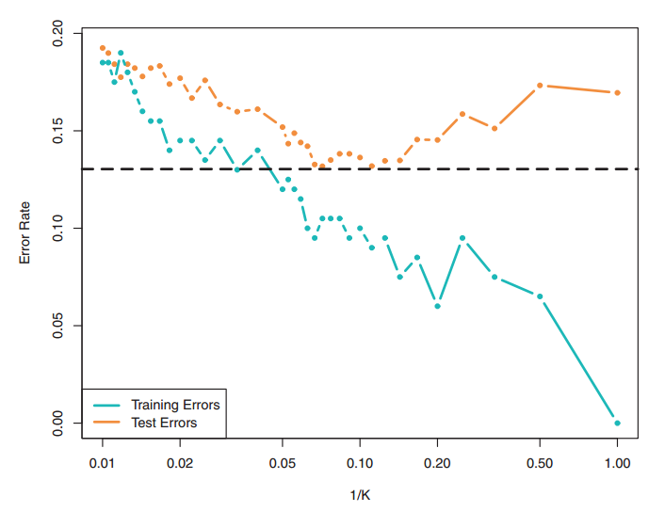
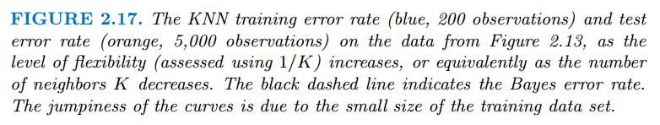
Training And Test Errors
This pattern is a common pattern for Machine Learning algorithms.
Can you explain the patterns?

Slide 11
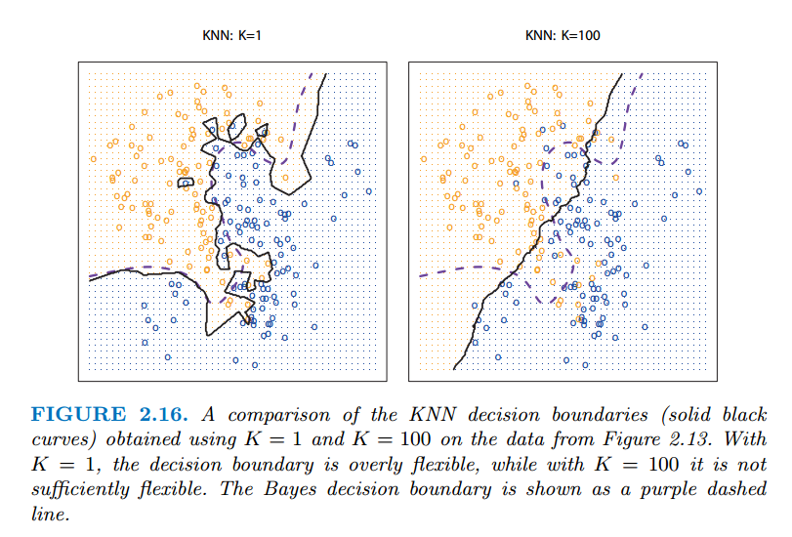
Effect of K
Rule of thumb – Use K = sqrt(#observations)

Slide 12
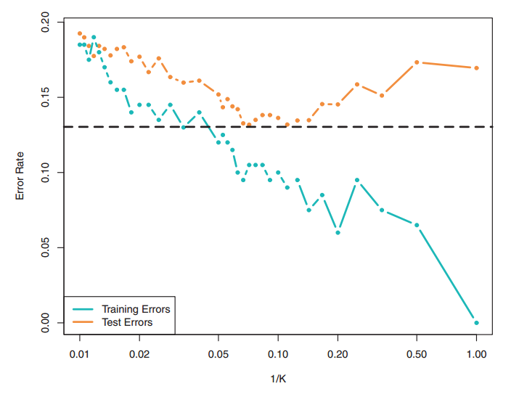
Effect of Model Flexibility (1/K)

Slide 13
Effect of Model Flexibility (1/K)

Slide 14
Exercises
On the Iris data:
Find the optimal number of neighbors for classification
Plot classification decision boundaries for k=5
Analyze whether the probability assigned is related to the actual accuracy

